Slide 1
EE4211 Data Science for IoT Project Student Proposal
Group 6
Ge Xuyan A0133904L Li Jinan A0224633L Yang Di A0229522H Zhang Lu A0138607B
(In alphabetical order)

Slide 2
Our Proposals
Gas Leakage Detection
User Behavior Model Clustering
Notes:
In this project, our group proposed two ideas: 1. Real-time Gas Leakage Detection, and 2. User behavior model clustering. The gas supplier can take advantage of these two evaluations to better supply gas to users and gain more knowledge from the users' behaviours.

Slide 3
Agenda
Motivation
Objective
Assumptions
Methodology
Results and Discussions
Conclusion and Limitations
References
Notes:
In the following sections, we will introduce each parts by Motivation, Objective, Assumption, Methodology, Results and Discussion, and Conclusion.

Slide 4
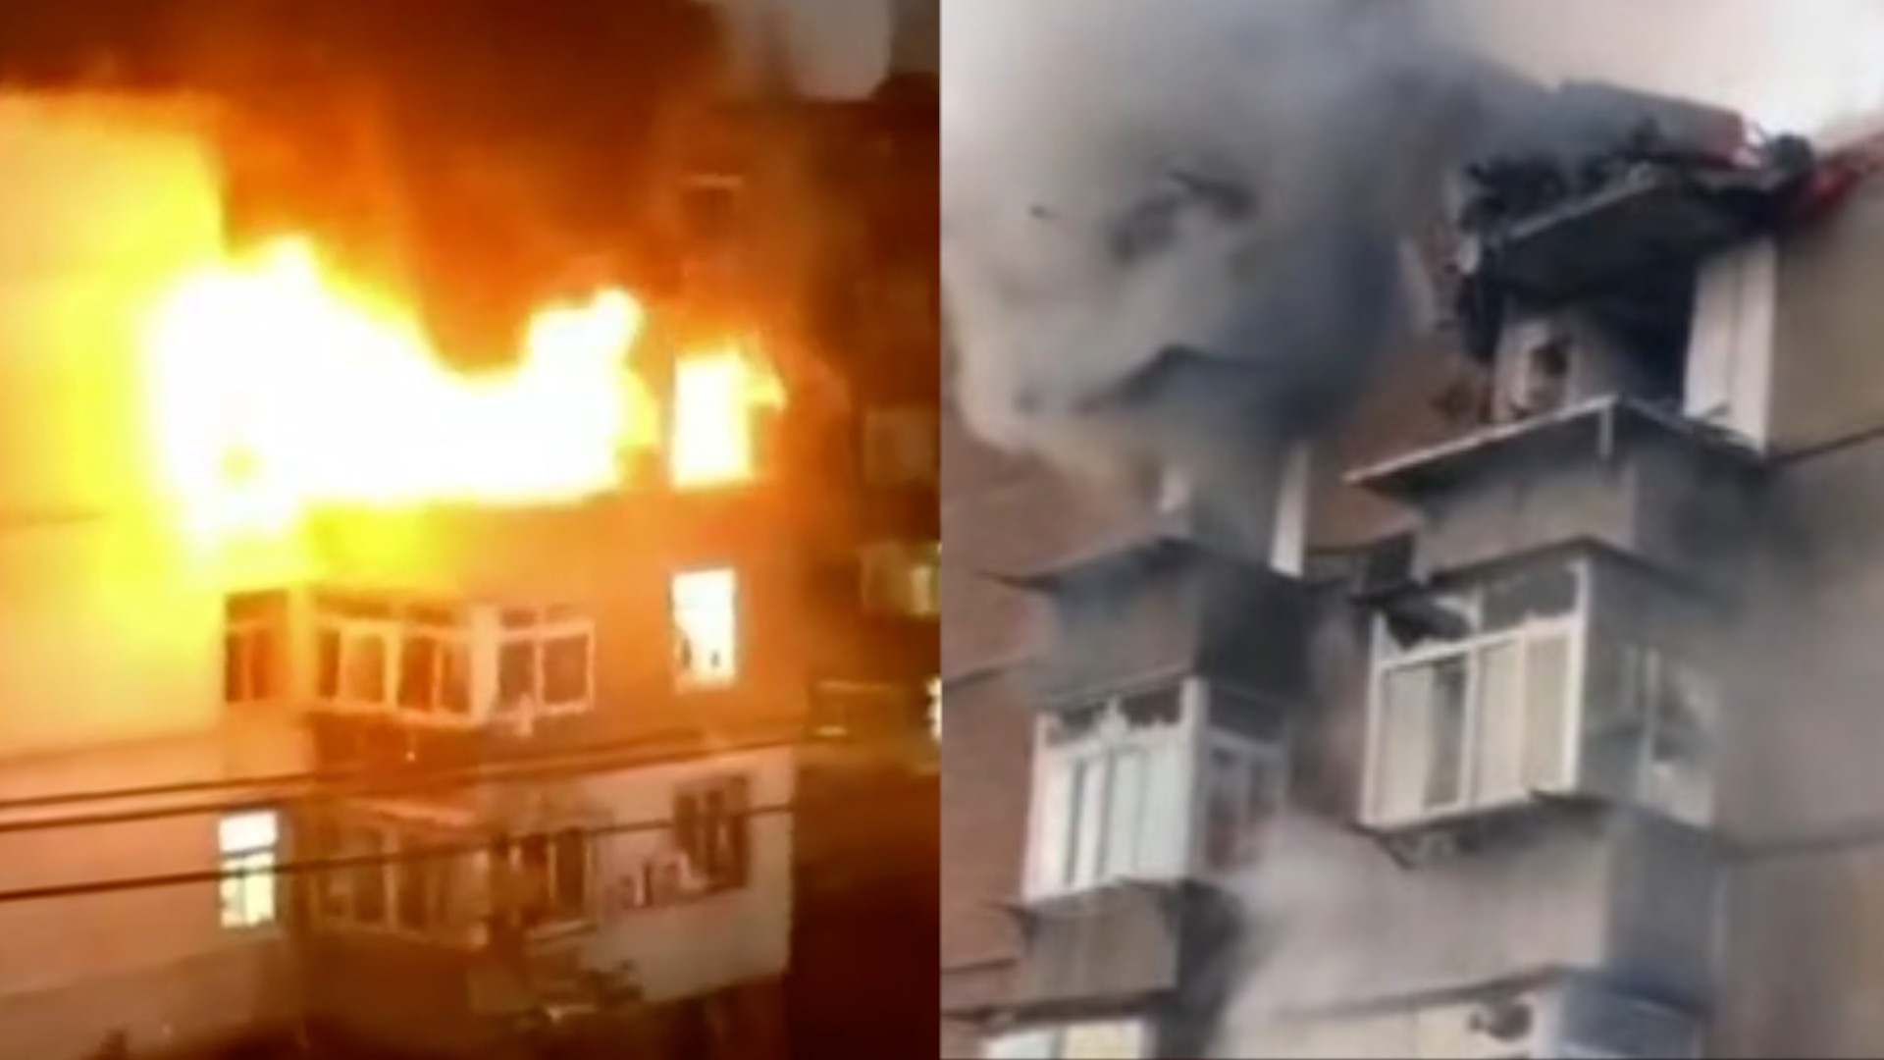
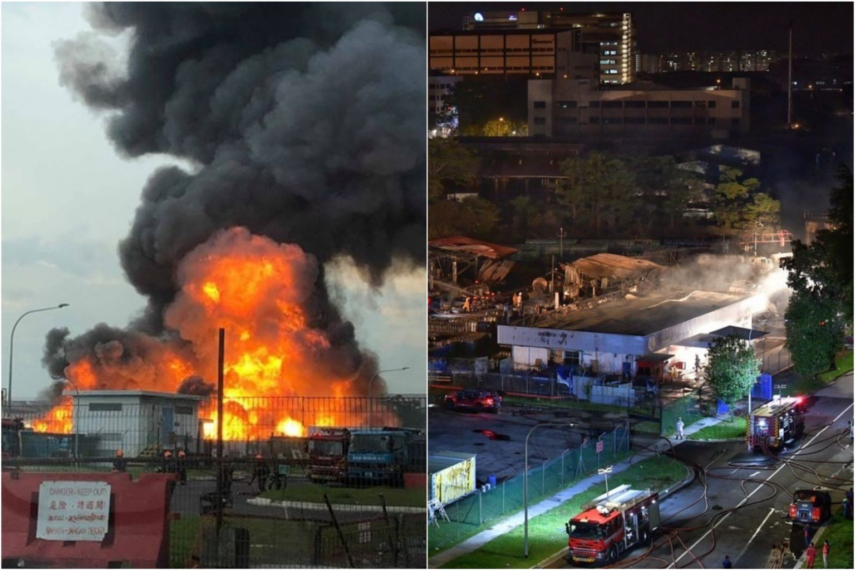
Gas Leakage Detection
Motivation
Town gas is colourless, odourless, flammable, explosive and toxic.
Leak at user end: gas explosion and toxication in the household
Leak In the pipeline transportation: more serious pipe explosion
Notes:
The gas leakage detection issue is important due to safety considerations. As town gas is colourless, odourless, flammable, explosive and toxic.If gas leaks for a long time at the user end, it may cause gas explosions and toxication in the household. If the leakage happens during the pipeline transportation, it may cause a more serious pipe explosion which the gas supplier obviously does not want to see.

Slide 5
Gas Leakage Detection
Objective
Our objective is to build a real-time gas leakage detection model and detect whether there is gas leaking at user side.
Notes:
Therefore, our objective is to build a real-time gas leakage detection model and detect whether there is gas leaking at user side.

Slide 6
Gas Leakage Detection
Assumptions
There is no gas leakage in the training dataset which is used to derive the threshold value. There may be gas leakage in the test dataset.
Each user has a nearly constant gas consuming habit in each week. The gas usage may vary between weekdays and weekends, but it has similar pattern between different weeks.
Notes:
In part1 we have two assumptions.

Slide 7
Gas Leakage Detection
Methodology
For each user:
Derive the Weekly Usage Behaviour Map
Add offset to form the Normal Usage Range
Compare the actual readings with the Normal Usage Range
Rationale: the gas usage has similar pattern between different weeks.
Notes:
For the overall methodology, we firstly derive the Weekly Usage Behaviour Map for each user, and then add offset values to form the Normal Usage Range for each user. Then, we compare the actual hourly readings with the Normal Usage Range to check if there is a possible gas leakage. The rationale behind this method is, as what we assumed, the gas usage has similar pattern between different weeks.

Slide 8
Gas Leakage Detection
Methodology
Data Pre-processing
Prune the Malfunctioning readings
Smooth the spiking data
Calculate the hourly readings for each user
Exceed threshold by seconds or minutes: user may use gas normally
Correct the decreasing data
Exceed threshold by day: slow alarm
Notes:
For the data preprocessing, the given dataset will firstly be preprocessed to prune the malfunctioning readings, which in detail is to smooth the spiking data and correct the decreasing data. Afterwards, we will calculate the hourly readings for each users. We choose to use hourly readings is because it is more reasonable. If actual readings exceed the threshold by seconds or minutes, the user may just use gas normally. If we check daily readings, the gas leakage issue would be alarmed too slowly.

Slide 9
Gas Leakage Detection
Methodology
Derive the threshold value for each user:
Healthy hourly readings data
Week 1
7*24=168 length array
Week 2
Take average
Weekly Usage Behaviour Map
+offset
Normal Usage Range (Threshold)
…
Week n
Notes:
To derive the threshold value, we plan to calculate the average hourly readings using several weeks of historical data in the dataset. As shown in the graph, the final threshold value set for each user will be a 7*24=168 length array.

Slide 10
Gas Leakage Detection
Methodology
False Alarms Prevention
Check whether the actual readings hit the threshold for a continuous period. If the actual hourly readings hit the threshold by 3 hours, we mark the user as gas leaking.
Cluster the users according to their gas using habits. If some users of same cluster suddenly consume more gas in the same period, consider it as a special case instead of gas leakage.
Notes:
Another aspect requiring further consideration would be what if our detection model is wrong, then we will raise many false alarms. To make our detection more confident in predicting that a gas leaking is really occurring, we need to check whether the actual readings hit the threshold for a continuous period. If the actual readings hit the threshold by 3 hours, we mark the user as gas leaking. Meanwhile, we will cluster the users according to their gas using habits. If some users of the same cluster suddenly consume more gas in the same period, we may consider it as a special case instead of gas leakage.

Slide 11
Results & Discussion
Leakage Detection Decision Map
Weekly Usage Behaviour Map
+Offset
Clustering
Normal Usage Range (Threshold)
Groups of Users
Hourly reading Data
Exceed threshold 1st time
Hour + 1
Exceed threshold 2nd time
Individual
Individual
Hour + 1
Exceed threshold 3rd time
In-group Checking
Cross Group Checking
Grouped
Grouped
Normal
Abnormal
Normal
Normal
Suspicious Leakage
Notes:
Suspicious

Slide 12
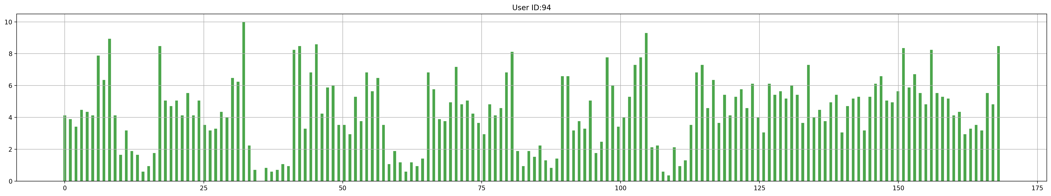
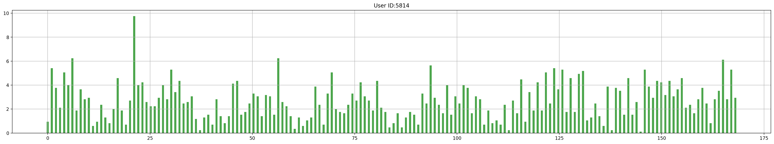
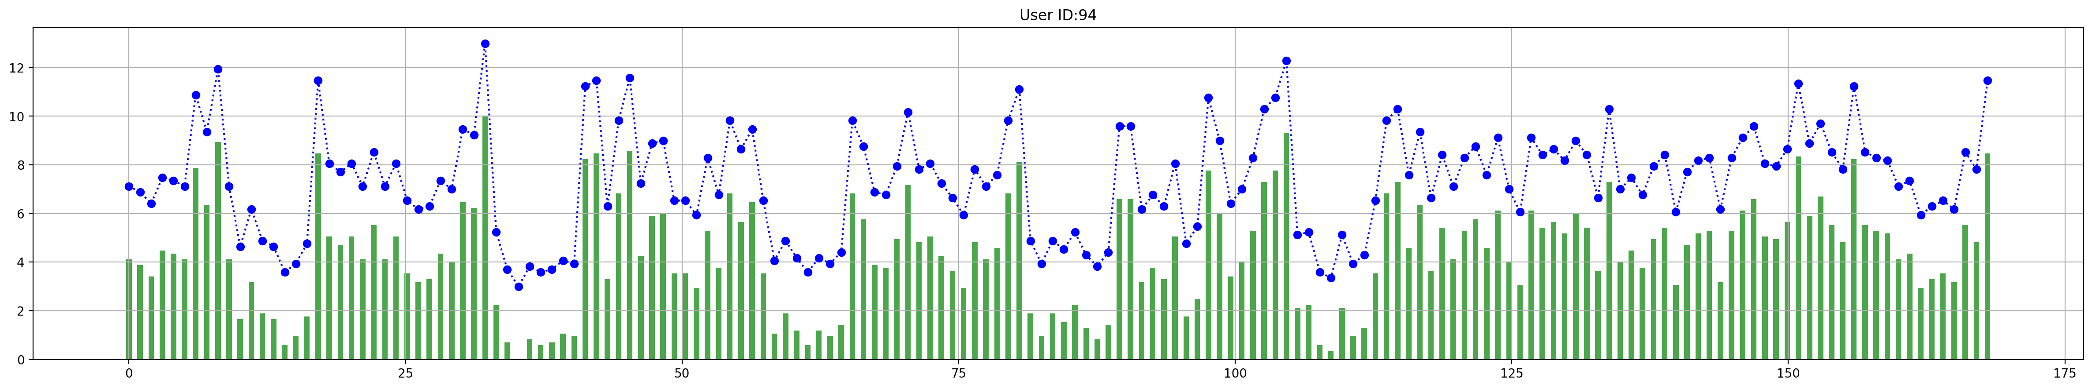
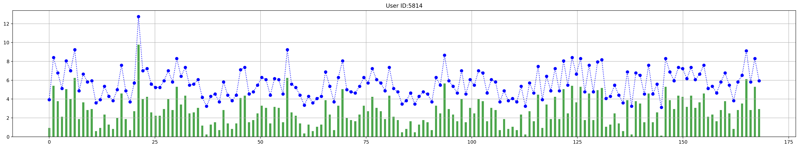
Weekly Usage Behaviour Map
Examples
User ID: 94
Weekly Usage Behaviour Map
User ID: 5814
2015-12-21 00:00:00 to 2015-12-28 00:00:00
+Offset
Normal Usage Range (Threshold)
2015-12-21 00:00:00 to 2015-12-28 00:00:00

Slide 13
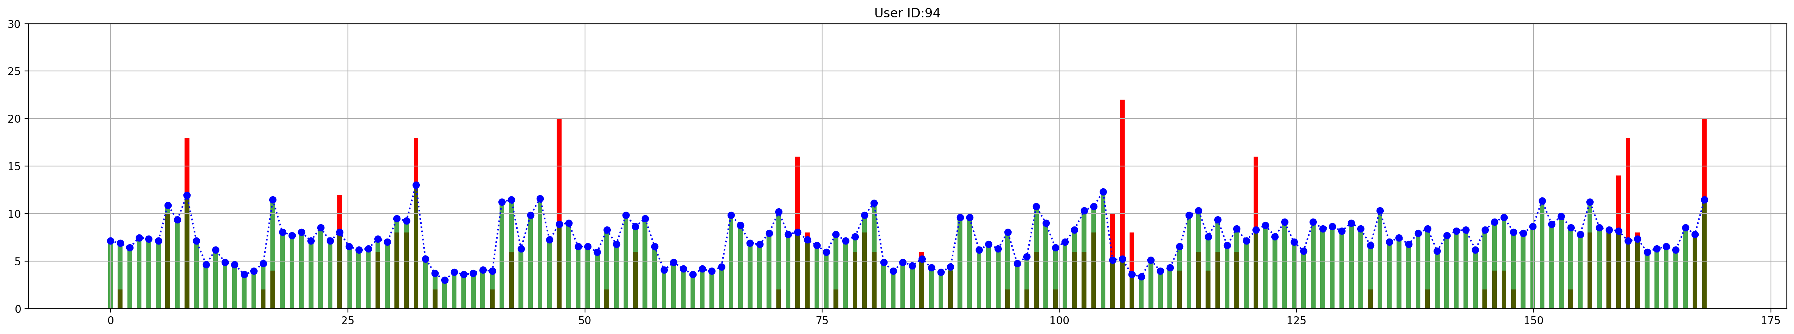
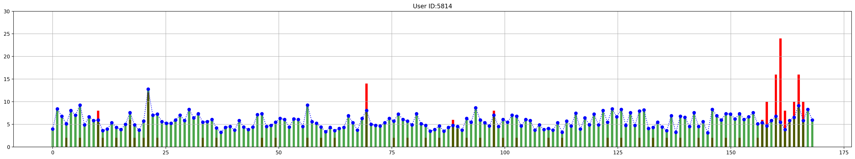
Abnormal Detection
Hourly reading Data
Exceed threshold 1st time
Hour + 1
Exceed threshold 2nd time
Hour + 1
Exceed threshold 3rd time
Examples
User ID: 94
Abnormal
User ID: 5814
Abnormal
2015-12-21 00:00:00 to 2015-12-28 00:00:00
Notes:
Failed for 3 continuous hours check

Slide 14
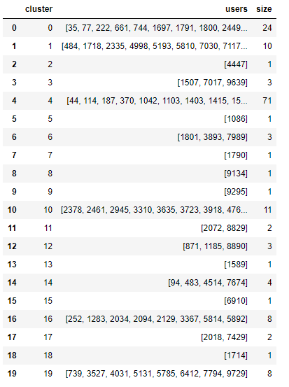
K means Clustering
Weekly Usage Behaviour Map
User ID: 94
Clustering
Groups of Users
User ID: 5814

Slide 15
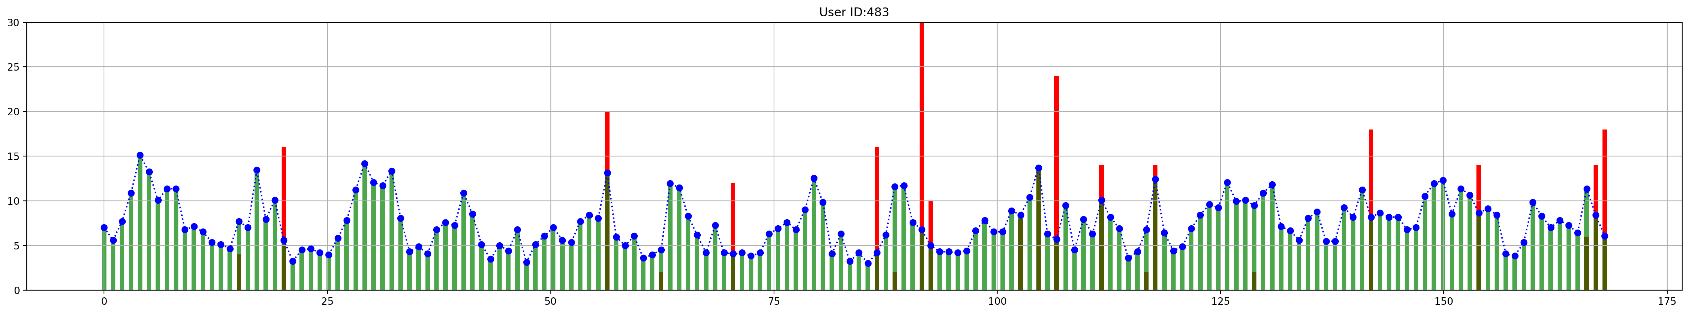
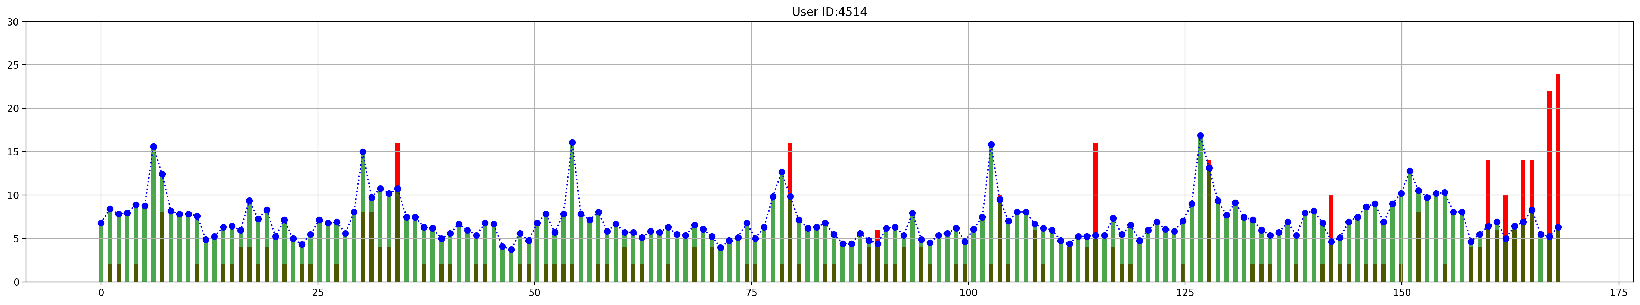
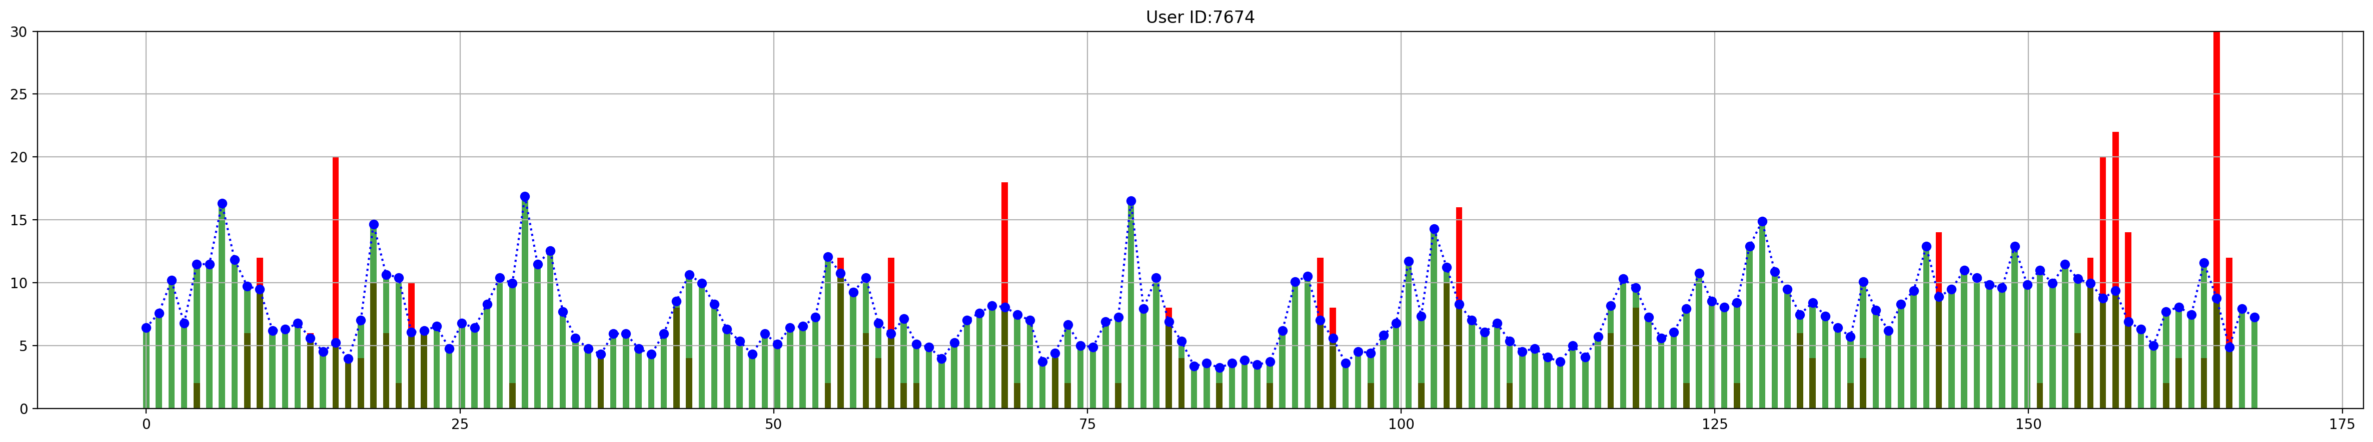
In-group Checking for User ID: 94
2015-12-21 00:00:00 to 2015-12-28 00:00:00
User ID: 94
Result
Abnormal
(Individual)
Normal
Normal
Normal
Group 14
User ID: 483
Group 14
User ID: 4514
Group 14
User ID: 7674
Group 14

Slide 16
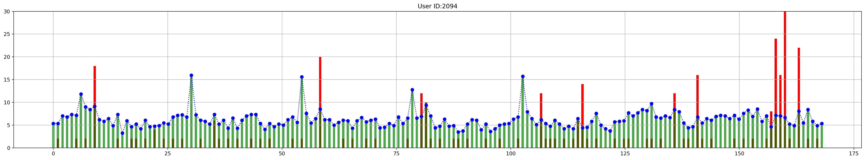
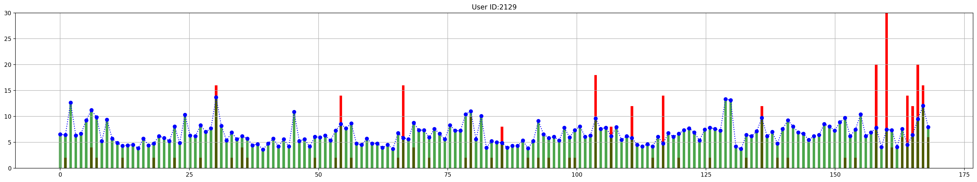
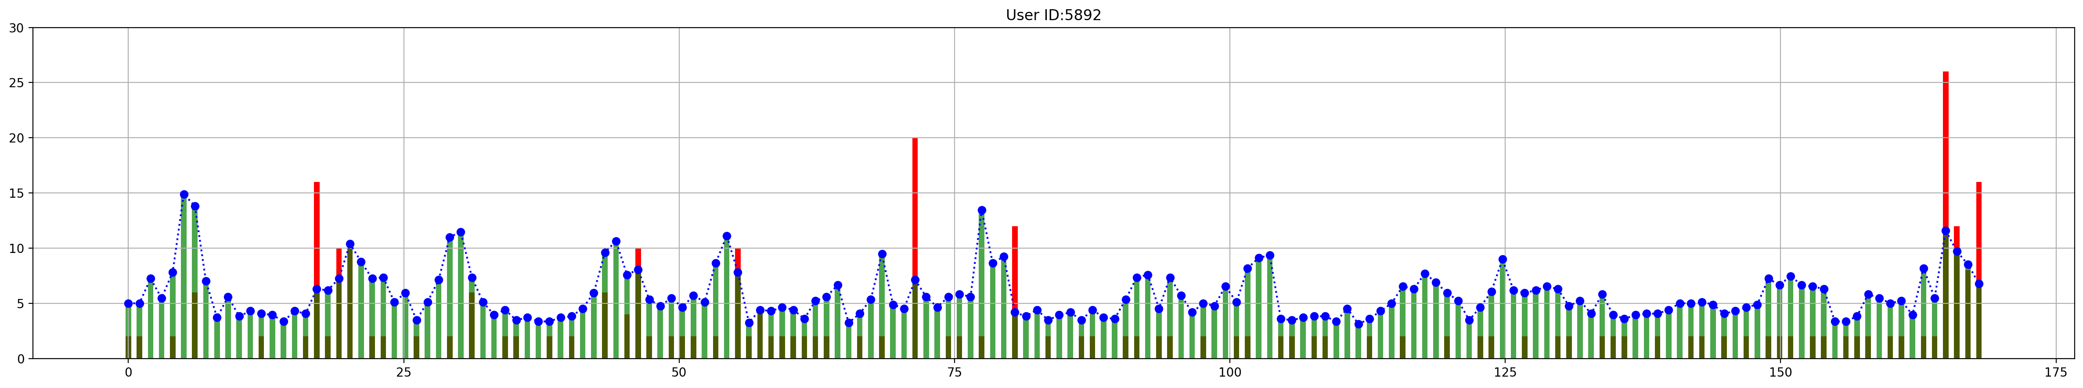
In-group Checking for User ID: 5814
2015-12-21 00:00:00 to 2015-12-28 00:00:00
User ID: 5814
Result
Abnormal
(Grouped)
Abnormal
Abnormal
Normal
Group 16
User ID: 2094
Group 16
User ID: 2129
Group 16
User ID: 5892
Group 16

Slide 17
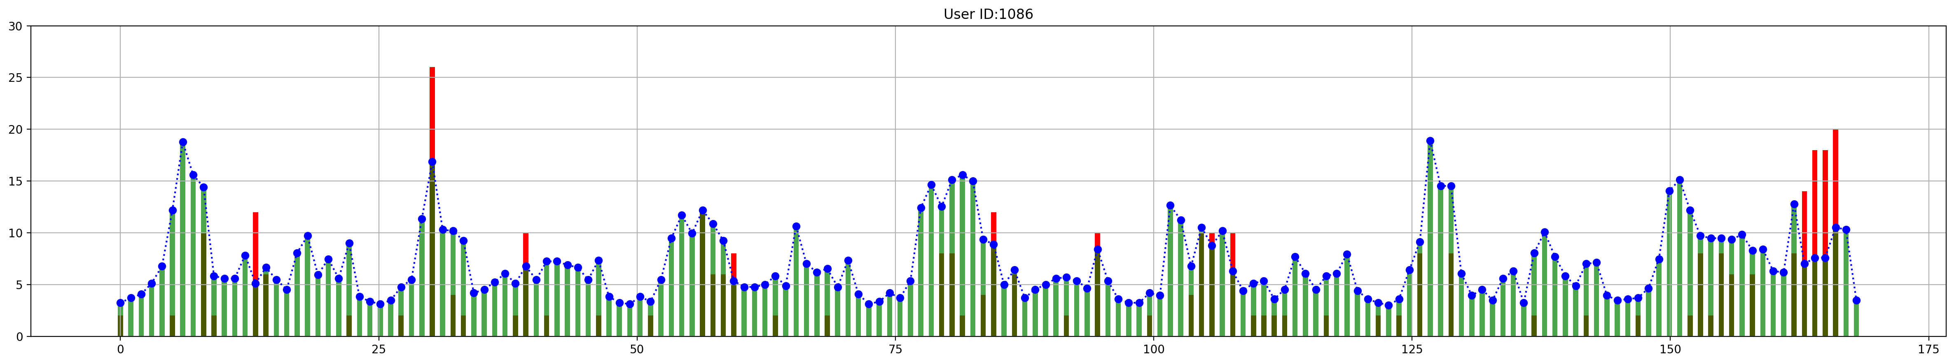
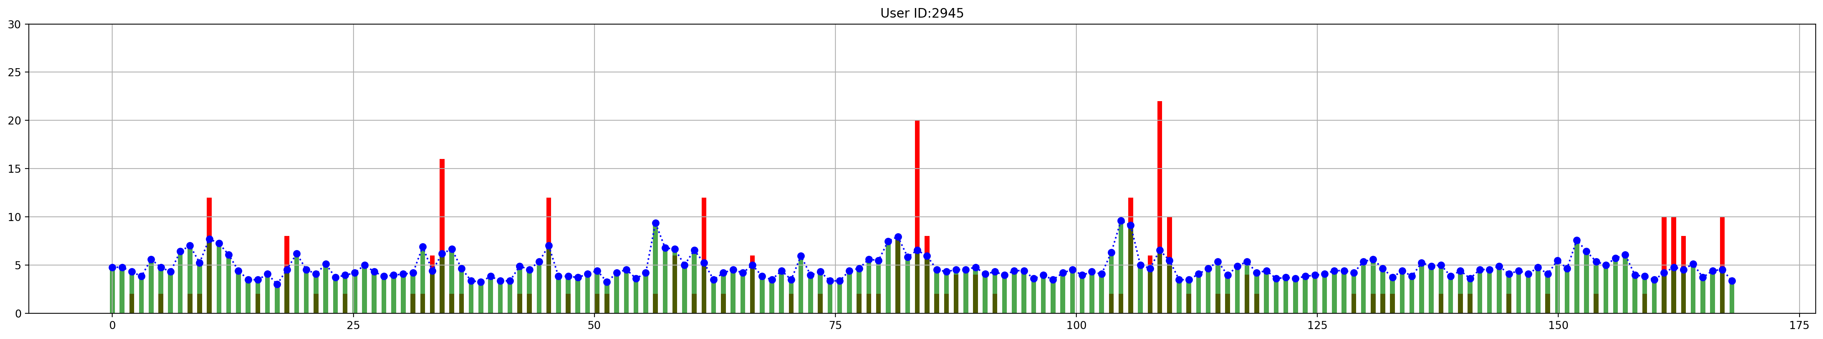
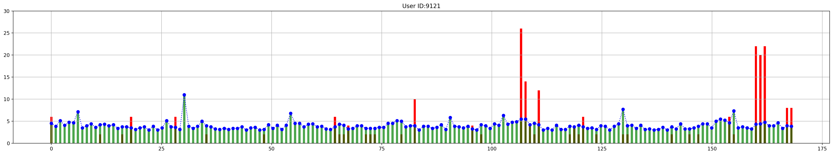
Cross Group Checking for User ID: 94
2015-12-21 00:00:00 to 2015-12-28 00:00:00
User ID: 94
Result
Abnormal
(Grouped)
Normal
Abnormal
Abnormal
Group 14
Group 14
User ID: 1086
Group 5
User ID: 2945
Group 10
User ID: 9121
Group 0

Slide 18
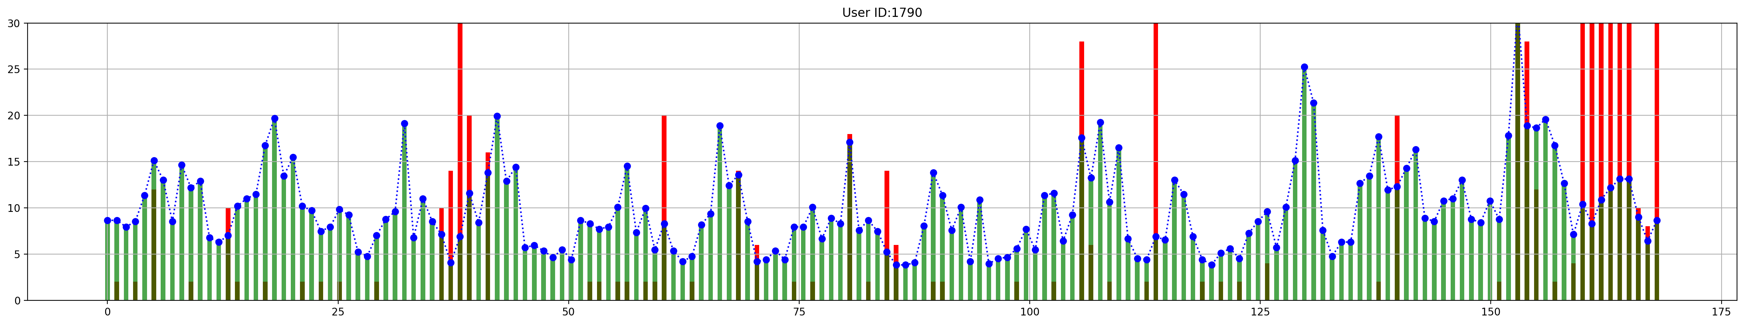
Suspicious Leakage
User ID: 1790
2015-12-21 00:00:00 to 2015-12-28 00:00:00
Suspicious Leakage
How about this part ?

Slide 19
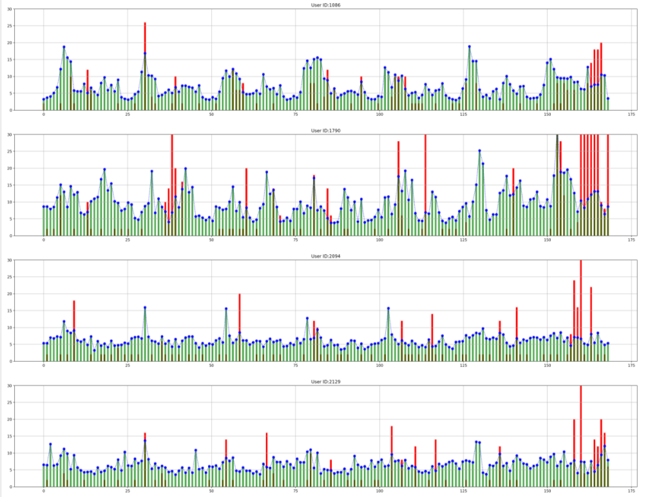
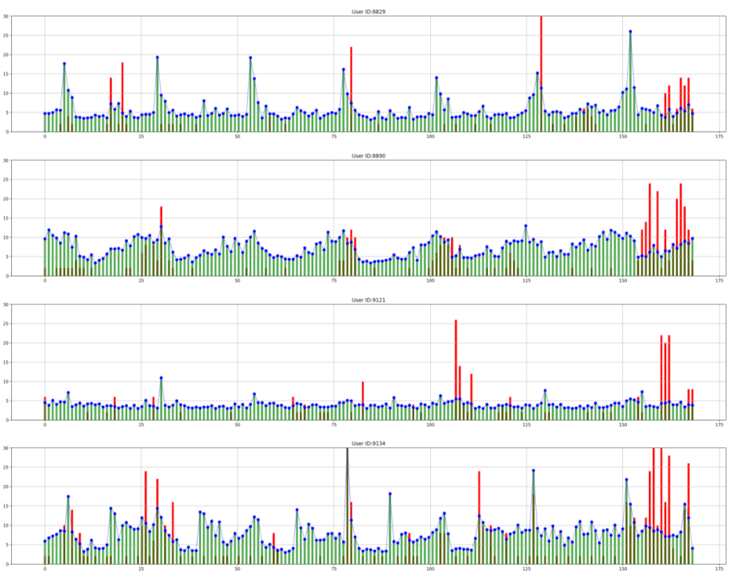
Suspicious Leakage
2015-12-21 00:00:00 to 2015-12-28 00:00:00
2015-12-21 00:00:00 to 2015-12-28 00:00:00
That day is the Christmas weekend !!!

Slide 20
Gas Leakage Detection
Conclusion & Limitations
Leakage Detection Method
Data Analysis
Lack of historical data and other supporting data
Lack of data labels, cannot verify model accuracy

Slide 21
User behavior model clustering
We will start this study from the following three parts
The impact of clustering results in terms of market
Categorize users based on gas consumption using a machine learning method of clustering
Validate the clustering results using other machine learning methods
Behavior Model

Slide 22



A more Comprehensive and Accurate User Profile Motivation http://www.woshipm.com/operate/3845129.html
Why do we need behavior model?
Marketing Promotion
Tiered pricing for gas

Slide 23


Grouping model vs individual model which one is better for our case?
The accuracy of the individual model is high. More refined services can be provided for key target users.
The cost of data acquisition and analytical processing of the subgroup model is relatively low, and in many cases good results can be obtained, which is cost-effective. It is especially suitable for large scale services.

Slide 24
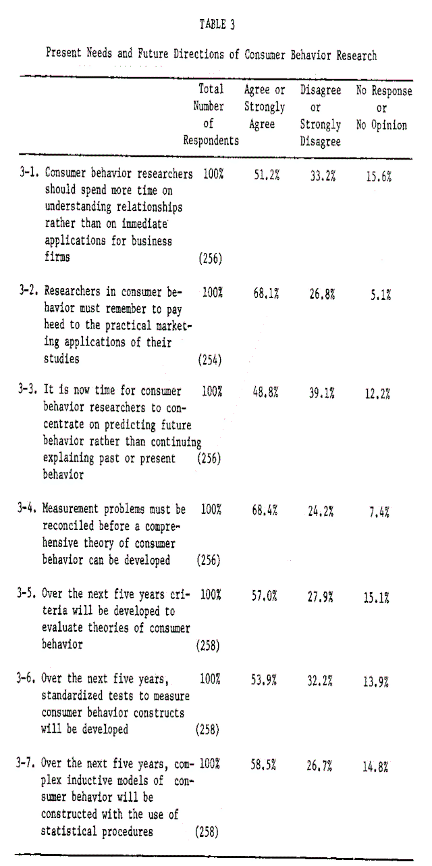
Grouping model Methodology Using Virtual DE questionnaire on behavior model
Home machine
Firstly, a detailed survey of a small group of users is conducted through questionnaires and other methods, and subsequently the behavior model of this small group of users is diffused into the same categories using a clustering model, at which point other strategies are used.
Assumptions: Some customers are willing to give their information or information stored in their gas company, such as location and gas usage, to commercial companies for a fee or something else.

Slide 25
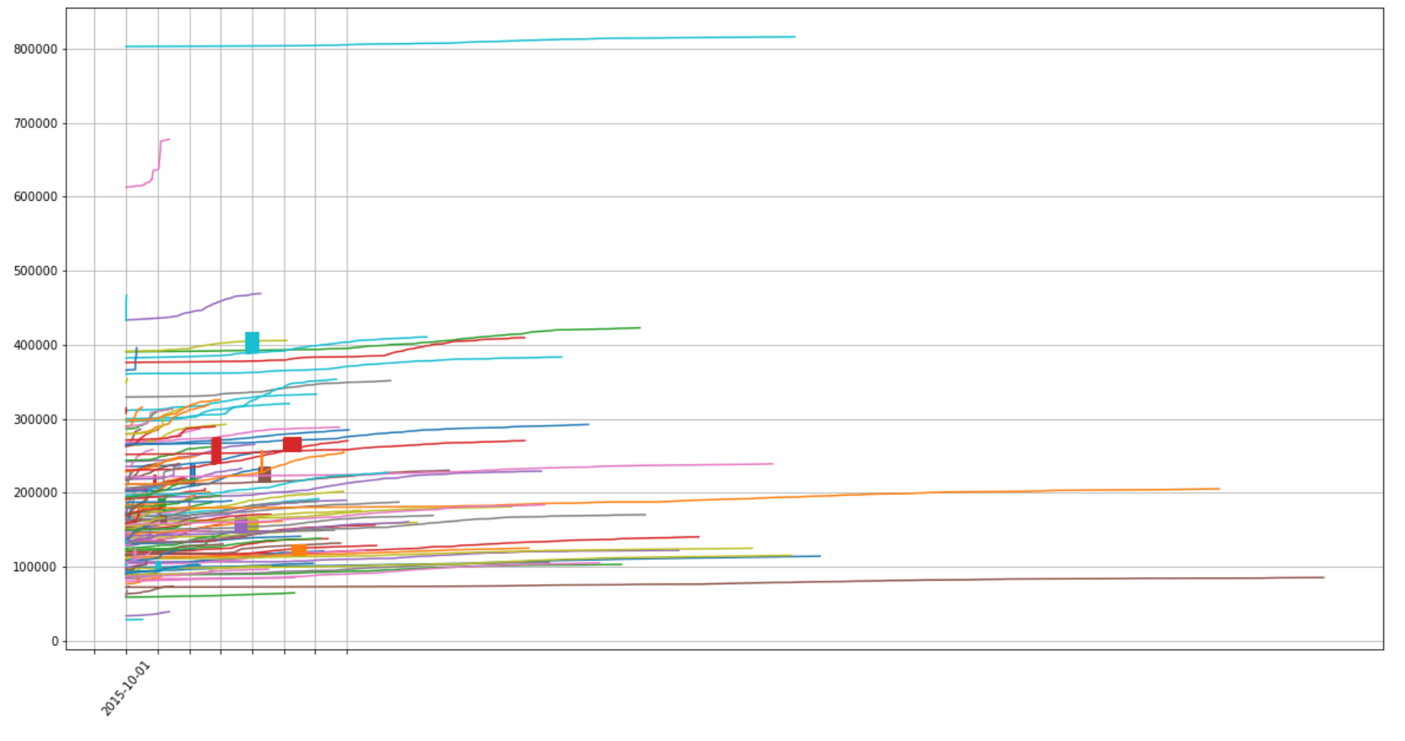
Clustering enabled by K-means and GMM
As for K-means:
It’s important to choose an proper K value. The best way is to try and error if we don’t have enough prior knowledge about data. Right here, we had a series of experiments based on different K and found out that the data could be clustered into 4 groups evenly and properly.
As for GMM:
We set the component number as 4. These 4 component need to share the same covariance matrix, so we set the covariance type as tied. We lead 0.1 as the non-negative regularization parameter to make sure the covariance matrices are all positive.
Then we compare the result of K-means, GMM clustering with correlation Groups of ‘top 5 most correlated meters’), as correlation and K-means, GMM are totally 3 different ways of measuring the similarity between data.
Gas meter cluster
Notes:
Next, we will use K-means and GMM method to achieve cluster on gas meter.
It’s important to choose an proper K value for k-means and components number for GMM.
In order to achieve proper clusters effectively, we will only use data in one certain month for clustering.
As we know, usually the gas fee is paid once per month, so monthly total gas consumption can provide a reference to enable gas tiered pricing, to chose data over one month is reasonable.
In addition, we want to investigate the user's gas usage habit, so the data variation in one certain month should be able to represent the variation trend in other months.
Why we set k and GMM component as 4?
By observing the time series plot of all gas meter reading, the reading’s orders of magnitude mainly gather around 100,000, 200,000 and 300,000, and the variation trend seems got 3 main kinds (smooth increase, oscillating change and step growth). Therefore, we assume that there are three main kinds of components and a extra unknown complementary element, we then choose k=4 along with trying other k value. Finally k=4 can achieve a proper cluster.

Slide 26
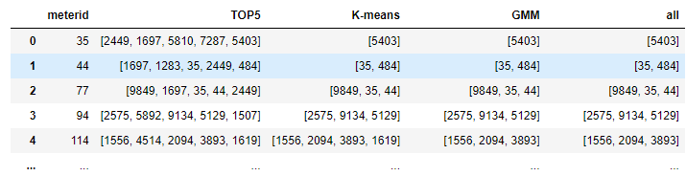
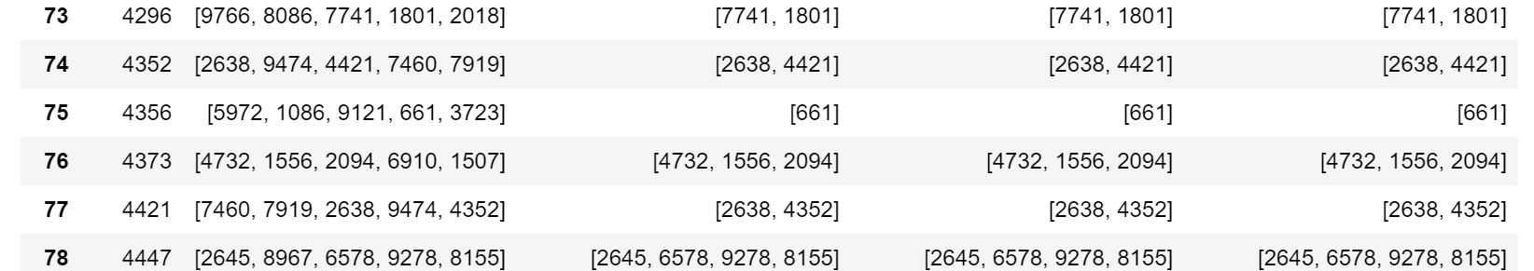
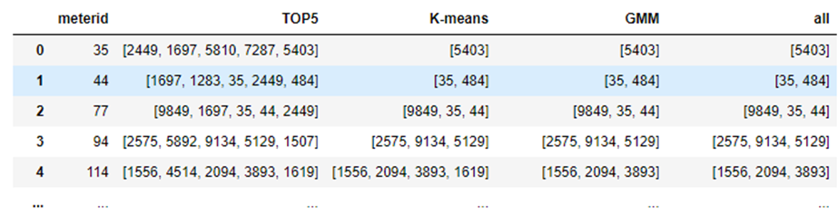
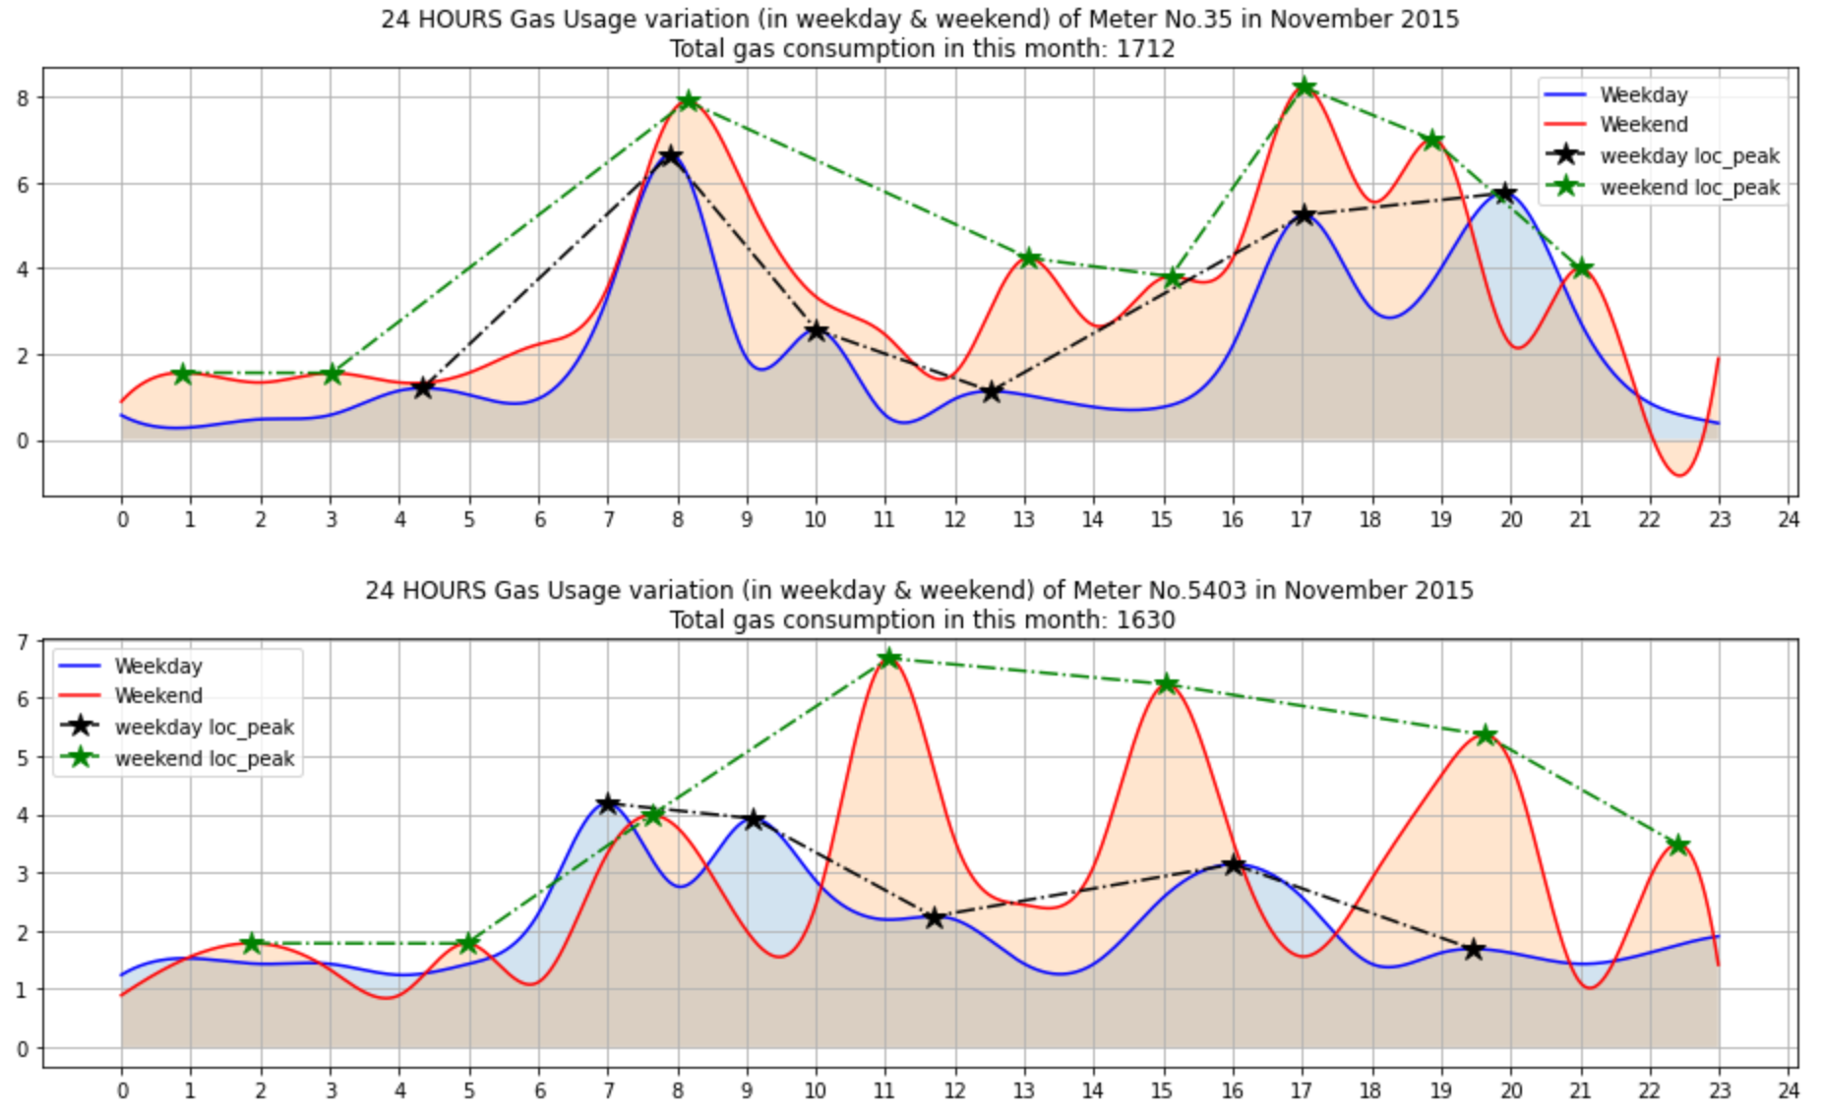
The gas meters existing in top 5 correlated, K-Means and GMM cluster.
57.325% of the K-means results can match that in top 5 correlation clusters.
61.401% of the GMM result can match that in top 5 correlation clusters.
In summary, 38.599% meters were in corresponding clusters based on all these 3 methods.
The hourly reading variation for Gas meter 35 and the gas meter, which was in the same cluster, in November 2015.
The Total Gas consumption in this month is around 1600.
Notes:
After clustering, we summary the gas meters which are in the same cluster with each other based on different clustering methods.
As shown in figure 1, ABOUT fifty seven % of the K-means results can match that in top 5 correlation clusters. Whereas ABOUT sixty one% of the GMM result can match that in top 5 correlation clusters. In summary, thirty eight% meters were in corresponding clusters based on all these 3 methods.
Then we select three clusters (based on data of October 2015) to present the average hourly reading variation in 24 hours period of a natural day (in weekday or weekend), three series plots indicate the gas usage laws for a family which can represent the gas usage habit.
Like the example given by gas meter 35 and 5403 in same cluster, their hourly reading variation over 24 hours in one day shows a closer trend. Such as the hourly gas consumption's peaks happen around 8am,14pm, 20pm in weekday separately. As for weekend, the gas consumption's peaks happen around 11am, 20pm.
At the same time, because the cluster for gas meter is based on their reading values as input. The close relationship between gas meter indicates that their gas consumptions are in the same orders of magnitude, which can provide a reference for implementing Tiered pricing of gas

Slide 27
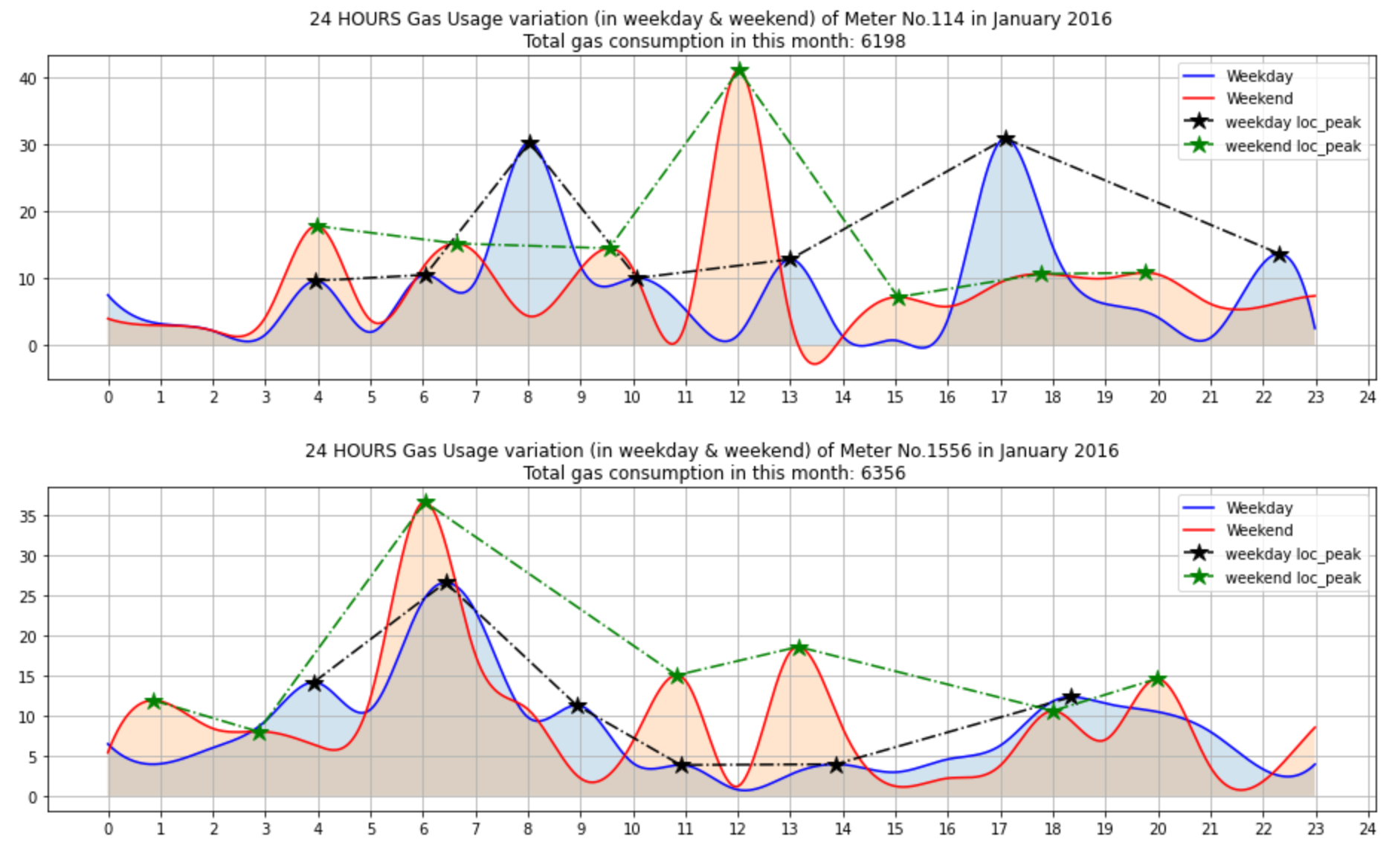
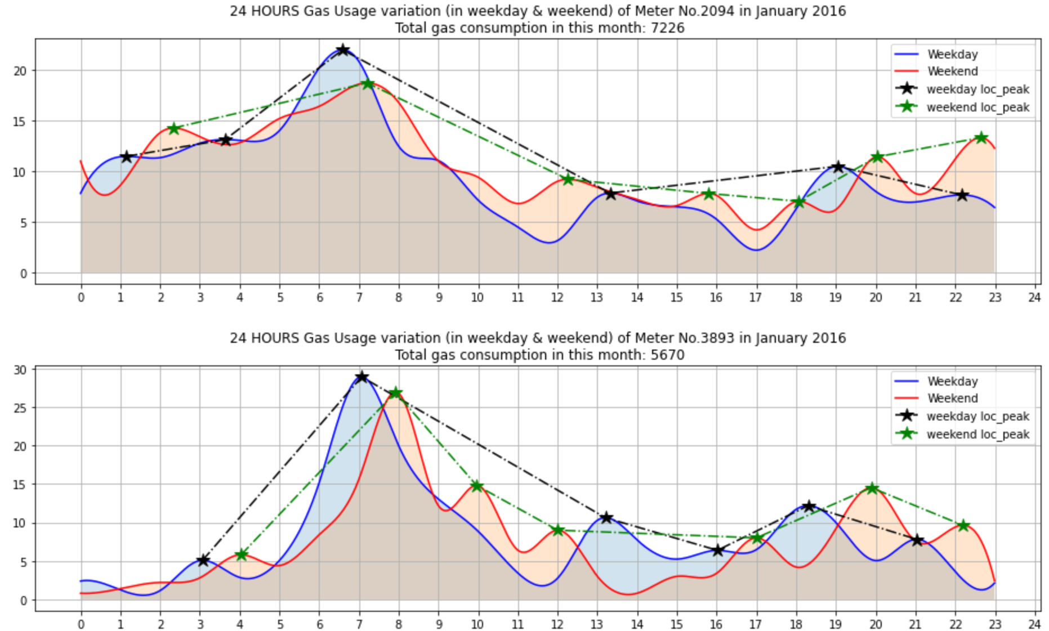
The hourly reading variation for Gas meter 114 and the gas meters, which were in the same cluster, in January 2016.
The Total Gas consumption in this month is around 6000.
Notes:
As for gas meter 114 and its closely relative gas meters 1556, 2094 and 3893. the hourly gas consumption's peaks arise around 7am,13pm and 18pm in weekday separately. As for weekend, the gas consumption's peaks happen around 6am, 12am and 20pm.
The Total Gas consumption in this month is around 6000.

Slide 28
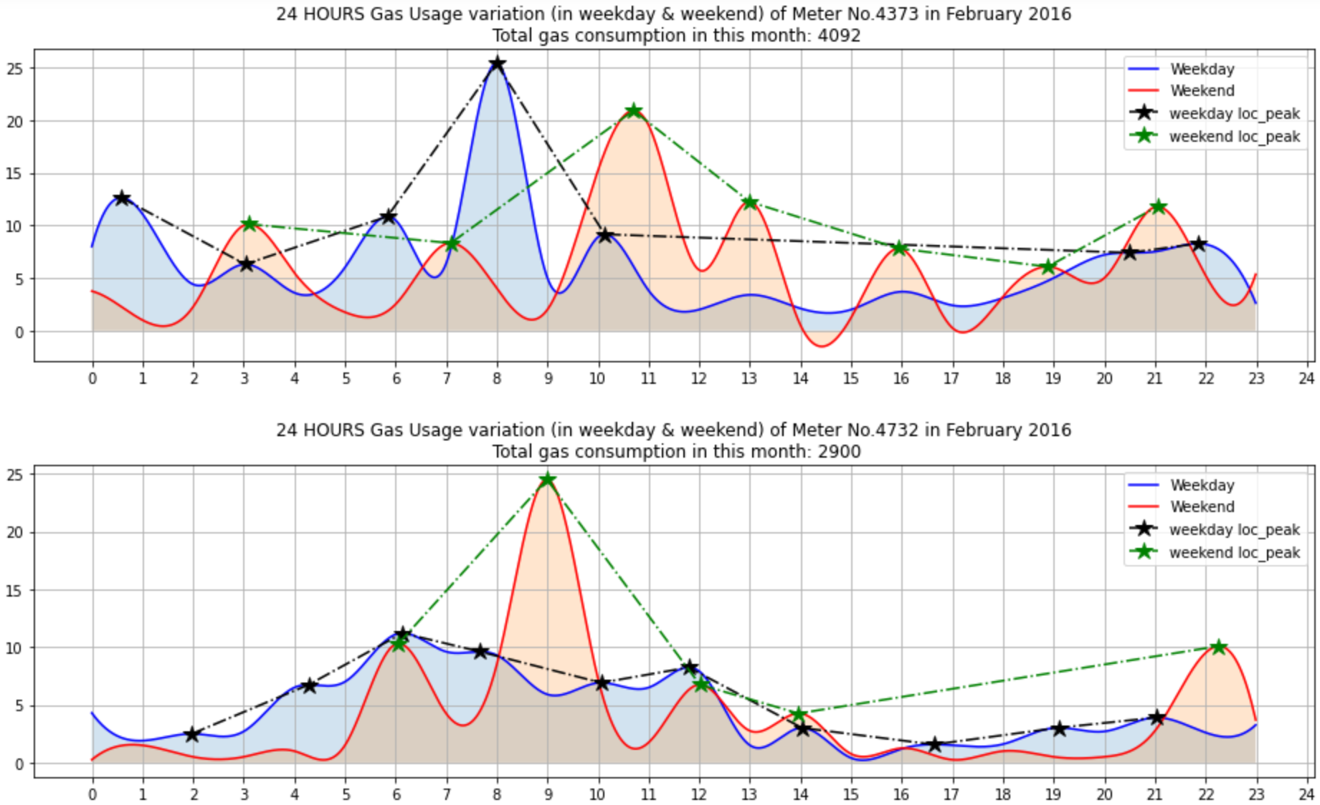
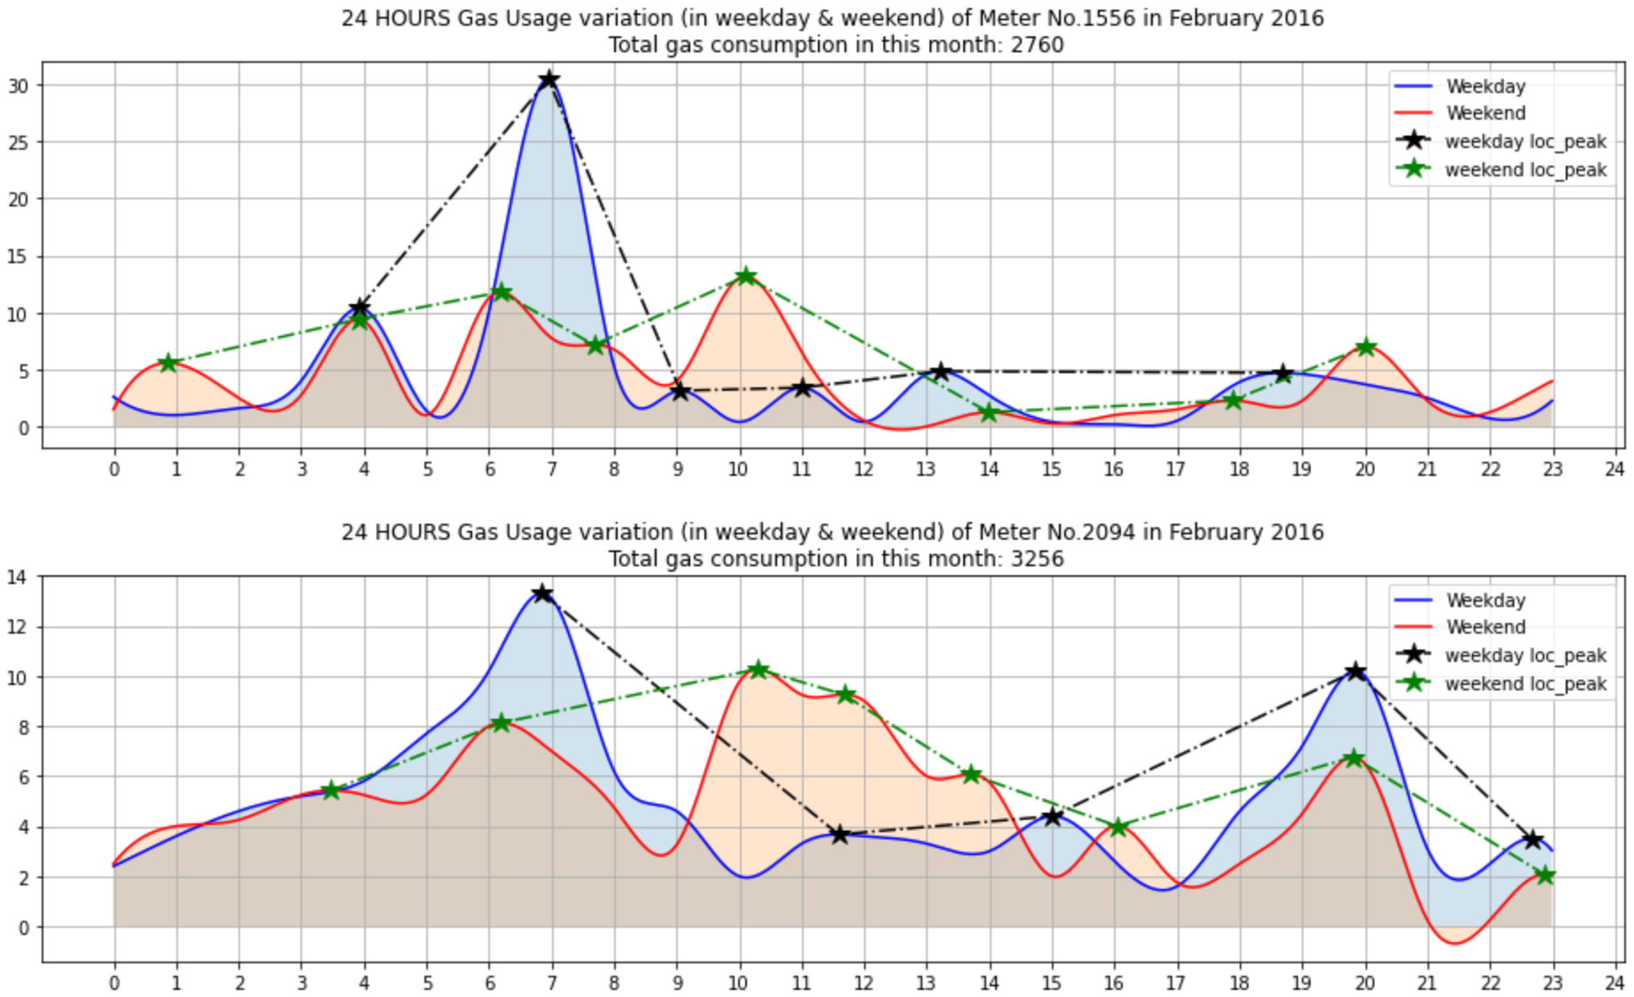
The hourly reading variation for Gas meter 4373 and the gas meters, which were in the same cluster, in February 2016.
The Total Gas consumption in this month is around 3000.
Notes:
As for gas meter 4373 and its close relative gas meter shown here. the hourly gas consumption's peaks arises around 7am,20pm, in weekday separately. As for weekend, the gas consumption's peaks happen around 10am and 20pm. We assume that the gas consumption peak reflects user’s behaviors like cooking, taking a shower or heating. The Total Gas consumption in this month is around 3000.
As shown in three series of plots, the gas meter reading variation have a close relationship, which indicates their close gas use habit.

Slide 29
Application enabled by the data analysis.
Leakage Detection
Smart dining Alarm;
Food delivery service recommendation at a proper time;
Tiered pricing for gas.
Indicate IOT.
Notes:
In summary, we can implement the data analysis results to achieve these Application scenarios.
Like Leakage detection, which can ensure user’s security. Pushing notification as Smart dining Alarm to show Customer care. And the takeout software can push Food recommendation at a proper time based on their habit. Gas Tiered pricing can also be supported by these data.
These scenario application indicates that the data can connect different things, which is a part of IoT Data as a Service.

Slide 30
Further work
To develop the more accurate and specific malfunction detection.
To collect enough data to study deeply about user’s habit based on gas usage.
To achieve a data based life service network.

Slide 31
References
https://www.straitstimes.com/singapore/loud-explosions-heard-thick-smoke-seen-as-fire-breaks-out-in-jalan-buroh-in-jurong
https://news.cgtn.com/news/2021-10-24/2-killed-7-injured-in-NE-China-gas-explosion-14CbYe2jjCU/index.html

Slide 32
Thanks for your attention!

